Slide 1

ELECTRIC THREE WHEELER WITH ACTIVE CAMBER SYSTEM
Professor; Antonio Carcaterra
Brighten Joseph
1713116
DEPARTIMENTO DI INGERIA INFORMATICA AUTOMATICA E GESTIONALE ANTONIO RUBERTI

Slide 2
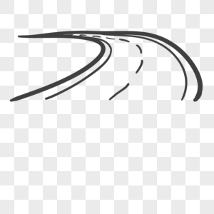
INTRODUCTION
Growing population in cities make designers and engineers a new challenge.
Small cars with less fuel consumption becoming necessary.
Three wheelers are used for the same reason in many countries as a part of public transportation system.
The biggest problem with three wheeler is that, not very stable in harsh maneuvers.

Slide 3
* Electric three wheeler
* A tadpole design
* In Wheel suspension system
* Cambering system will be incorporated in each wheel in order to improve the handling and stability of this vehicle

Slide 4
Lateral stability
1 Rollover acceleration thrush hold

Slide 5
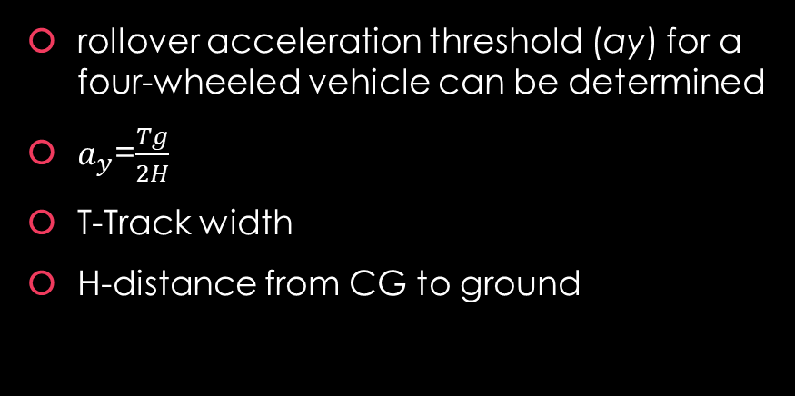
Lateral stability
tendency of the moving vehicle to go back to its original direction when
disturbed from that direction
Roll over
rollover acceleration threshold (ay) for a four-wheeled vehicle can be determined
$a_{y}$=$\frac{Tg}{2H}$
T-Track width
H-distance from CG to ground

Slide 6
SAE vehicle coordinate orientations, where the zero point of the
coordinate system is attached to the vehicle centre of gravity (CG).

Slide 7
Effects on yaw rate by varies inputs
Applying camber angle on handiling using 3 degree of freedom
All wheels are independently steerable while camber angles can be
applied to all wheels, separately.

Slide 8









Lateral force acting on each tire
$$F_{y1}=C_{α1}α_{1}+C_{γ1}γ_{1}$$
$$F_{y3}=C_{α3}α_{3}+C_{γ3}γ_{3}$$
General motion equations
$$F_{y2}=C_{α2}α_{2}+C_{γ2}γ_{2}$$
Eq.1
Total lateral force acting
$F_{y1}+F_{Y2}+F_{y3}=M$($\dot{v}+ur$)
Taking momentum about cg
Eq.2
Slip angles in terms of steering angle
$a\left(F_{y1}+F_{y3}\right)−bF_{y2}+M_{z}$=$I_{z}\dot{r}$
Momentum about roll center
$$α_{1}=δ_{1}−(\frac{v+ar}{u})$$
Eq.3
$$I_{x}\ddot{φ}+c_{t}\dot{φ}+\left(k_{t}−m_{s}gh\right)φ=−m_{s}\acute{h}\text{(}\dot{v}+ur\text{)}$$
$$α_{3}=δ_{3}−(\frac{v+ar}{u})$$
$$α_{2}=δ_{2}−(\frac{v−br}{u})$$

Slide 9

Eq.4
$c_{α1}δ_{1}−c_{α1}(\frac{v+ar}{u})+c_{γ1}γ_{1}+c_{α3}δ_{3}−c_{α3}(\frac{v+ar}{u})+c_{γ3}γ_{3}$+ $c_{α2}δ_{2}−c_{α2}\left(\frac{v−br}{u}\right)+c_{γ2}γ_{2}=M\text{(}\dot{v}+ur\text{)}$
Eq.5
$c_{α1}δ_{1}a−c_{α1}\left(\frac{v+ar}{u}\right)a$+ $c_{γ1}γ_{1}a$+$c_{α3}δ_{3}a−c_{α3}\left(\frac{v+ar}{u}\right)a$+ $c_{γ3}γ_{3}a$- $c_{α2}δ_{2}b+c_{α2}\left(\frac{v−br}{u}\right)b$+ $c_{γ2}γ_{2}b$+$M_{z}=I_{z}\dot{r}$
$c_{γ1,2,3}−$camber coefficient
$c_{α1,2,3}−$ cornering coefficient
$I_{z}$, $I_{x}−$ moment of inertia about x, y
$M_{z}−$ controlling moment
$δ_{1,2,3}−$steer angles
r – yaw rate
$$m_{s}−unsprung mass$$
$α_{1,2,3}−$slip angles
a,b – distance from cg point to front and rear axcel
u,v – longitudinal and lateral velocity

Slide 10

Re arranging eq 4
$$\left\lfloor mS+\frac{c_{α1}+c_{α2}+c_{α3}}{u}\right\rfloor v\left(S\right)=−\left[mu+\frac{ac_{α1}+ac_{α3}−bc_{α2}}{u}\right]r(S)$$
$v\left(S\right)$= - $\frac{mu^{2}+ac_{α1}+ac_{α3}−bc_{α2}}{c_{α1}+c_{α2}+c_{α3}+muS}r(S)$
Re arranging eq 5
$Mz−\left[\frac{ac_{α1}+ac_{α3}−bc_{α2}}{u}\right]v\left(S\right)$= $\left[IzS+\frac{a^{2}c_{α1}+a^{2}c_{α3}+b^{2}c_{α2}}{u}\right]r(S)$

Slide 11
$$\frac{Gr}{γ_{1or3}}=\frac{uc_{γ1}c_{α2}(a+b)}{\left(\left(c_{α1}+c_{α2}+c_{α3}\right)Iz+m\left(a^{2}c_{α1}+a^{2}c_{α3}+b^{2}c_{α2}\right)\right)uS+a^{2}c_{α1}c_{α2}+a^{2}c_{α2}c_{α3}+b^{2}c_{α1}c_{α2}+b^{2}c_{α3}c_{α2}+2c_{α3}c_{α2}ab+{2c}_{α1}c_{α2}ab}$$
$\frac{Gr}{γ_{2}}$= $\frac{uc_{γ2}c_{α2}(a+b)}{\left(\left(c_{α1}+c_{α2}+c_{α3}\right)Iz+m\left(a^{2}c_{α1}+a^{2}c_{α3}+b^{2}c_{α2}\right)\right)uS+a^{2}c_{α1}c_{α2}+a^{2}c_{α2}c_{α3}+b^{2}c_{α1}c_{α2}+b^{2}c_{α3}c_{α2}+2c_{α3}c_{α2}ab+{2c}_{α1}c_{α2}ab}$
$\frac{Gr}{Mz}$= $\frac{u\left(c_{α1}+c_{α2}+c_{α3}\right)}{\left(\left(c_{α1}+c_{α2}+c_{α3}\right)Iz+m\left(a^{2}c_{α1}+a^{2}c_{α3}+b^{2}c_{α2}\right)\right)uS+a^{2}c_{α1}c_{α2}+a^{2}c_{α2}c_{α3}+b^{2}c_{α1}c_{α2}+b^{2}c_{α3}c_{α2}+2c_{α3}c_{α2}ab+{2c}_{α1}c_{α2}ab}$

Slide 12




State space
$$x=\begin{matrix}v \\ r \\ \begin{aligned}\dot{φ} \\ φ \\ \dot{v}\end{aligned}\end{matrix}$$
$$\dot{X}=Ax+Bn$$
$$y=Cx+Dn$$
$$n=\begin{matrix}M_{z} \\ γ_{1} \\ \begin{aligned}γ_{2} \\ γ_{3} \\ δ_{1} \\ δ_{2} \\ δ_{3}\end{aligned}\end{matrix}$$
Transfer function for SISO
$$G\left(s\right)=C{(sI−A)}^{−1}B+D$$

Slide 13


$$A=\begin{matrix}\frac{−(c_{α1}+c_{α2}+c_{α3})}{mu} & \frac{−ac_{α1}−ac_{α3}+bc_{α2}}{mu} & 0 & 0 & 0 \\ \frac{−(c_{α1}+c_{α2}+c_{α3})}{Izu} & \frac{−(a^{2}c_{α1}+a^{2}c_{α3}+b^{2}c_{α2})}{Izu} & 0 & 0 & 0 \\ 0 & 0 & 0 & 0 & 0 \\ 0 & \frac{m_{s}h′u}{Ix} & \frac{−m_{s}h′}{Ix} & \frac{−ct}{IX} & \frac{−(kt−m_{s}hg)}{Ix} \\ 0 & 0 & 0 & 0 & 1\end{matrix}$$
B$=\begin{matrix}0 & c_{γ1}/m & c_{γ2}/m & c_{γ3}/m & c_{α1}/m & c_{α2}/m & c_{α3}/m \\ 1/Iz & c_{γ1}a/Iz & c_{γ2}b/Iz & c_{γ3}a/Iz & ac_{α1}/Iz & bc_{α2}/Iz & ac_{α3}/Iz \\ 0 & 0 & 0 & 0 & 0 & 0 & 0 \\ 0 & 0 & 0 & 0 & 0 & 0 & 0 \\ 0 & 0 & 0 & 0 & 0 & 0 & 0\end{matrix}$
C= identity matrix 5*5
D=0

Slide 14
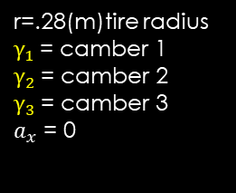

Values used
$c_{α1}$=25000 N/rad
$c_{α3}$=25000N/rad
$c_{α2}$=40000N/rad
M=900kg vehicle mass
u=15,40,65,90(u/3.6 m/s) longitudinal velocity
a=.8 distance from cg location to rear wheel
b=1 distance from cg location to rear wheel
l= a+b total length
T=1.4- track length
$k_{s}$=12000 N/m spring constant
$c_{s}$=800 Nm/sec damper
$m_{s}$=780; sprung mass
$I_{x}$=210; moment of inertia about x axis
$c_{t}$=0.2${ c}_{s} T^{2}$
$k_{t}$=0.2 $k_{s} T^{2}$
h=0.53
g=9.8m/s2
$c_{γ1}$=0.1 $c_{α1}$
$c_{γ3}$=0.1 $c_{α3}$
$c_{γ2}$=0.1 $c_{α2}$
$I_{z}$=81
g=9.8 m/(s^2)
h=.2(m) cg to roll centre
H=.5(m) cg to ground
h’’ =0.3 cg to ground
r=.28(m)tire radius
$γ_{1}$= camber 1
$γ_{2}$= camber 2
$γ_{3}$= camber 3
$a_{x}$ = 0

Slide 15
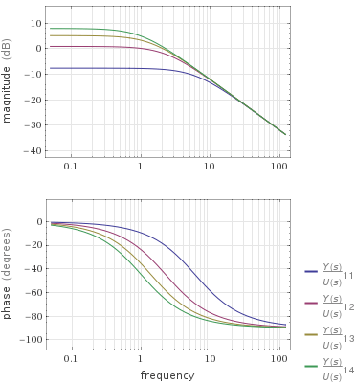
Front wheel camber angle effect on yaw
https://www.wolframalpha.com/widgets/view.jsp?id=294630c7fceb95fecbb446b26ea16b4b

Slide 16
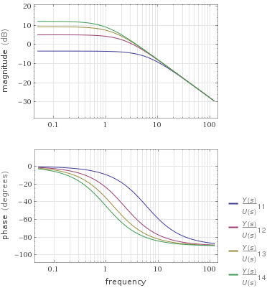
Rear wheel camber angle effect on yaw rate

Slide 17

Effect of controlling moment Mz on yaw

Slide 18
front wheels
all wheels
 | yaw rate(rad/sec) | lateral acceleration generated by applied camber angle(m/sec) | yaw rate | acceleration due to applied camber angle
u=15 | 9.8*e-5 | 0.000284 | 0.182 | 4.309*e-5
 | 7.65*e-5 | 0.000221 | 0.364 | 0.000362
 | 0.000117 | 0.0003424 | 0.5455 | 0.00182
 | 0.000371 | 0.0001083 | 0.7277 | 0.002286
 | 0.000544 | 0.0001589 | 0.9102 | 0.0028
 | 0.000274 | 0.0004454 | 1.092 | 0.00339
u=40 | 0.47 | 0.0001056 | 0.4854 | 6.327*e-5
 | 0.484 | 8.487*e-5 | 0.9708 | 0.000113
 | 0.485 | 0.0001322 | 1.456 | 0.00012
 | 0.4853 | 0.0004179 | 1.942 | 0.000194
 | 0.4851 | 0.00109 | 2.427 | 0.000631
 | 0.4845 | 0.0011 | 2.911 | 0.001559
u=65 | 0.789 | 0.0003783 | 0.789 | 0.000139
 | 0.7892 | 0.000618 | 1.578 | 0.000277
 | 0.7895 | 0.0008576 | 2.367 | 0.000416
 | 0.7897 | 0.001097 | 3.156 | 0.000555
 | 0.79 | 0.001337 | 3.945 | 0.000693
 | 0.7902 | 0.001515 | 4.734 | 0.000838
u=90 | 1.094 | 0.004132 | 1.094 | 0.001515
 | 1.098 | 0.006748 | 2.189 | 0.003029
 | 1.102 | 0.009367 | 3.283 | 0.004544
 | 1.105 | 0.01198 | 4.377 | 0.006059
 | 1.109 | 0.0146 | 5.472 | 0.007573
 | 1.112 | 0.0196 | 6.164 | 0.00908

Slide 21
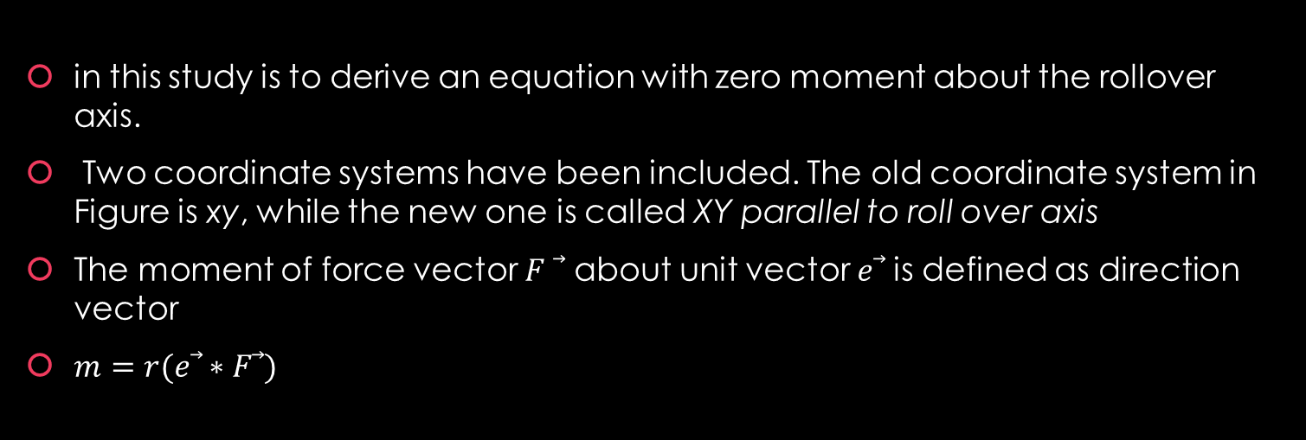




Rollover Threshold
in this study is to derive an equation with zero moment about the rollover axis.
Two coordinate systems have been included. The old coordinate system in Figure is xy, while the new one is called XY parallel to roll over axis
The moment of force vector 𝐹 ⃗ about unit vector 𝑒⃗ is defined as direction vector
$m=r(\text{e}\text{⃗}∗\text{F}\text{⃗})$
direction of the roll axis
$$e=e_{i}i+e_{j}j+e_{k}k$$
distance vector between force vector
$$M=\begin{matrix}e_{i} & e_{j} & e_{k} \\ r_{i} & rj & r_{k} \\ F_{i} & F_{j} & F_{k}\end{matrix}$$
$$r=r_{i}i+rj+r_{k}k$$
$$F=F_{i}i+F_{j}j+F_{k}k$$

Slide 22
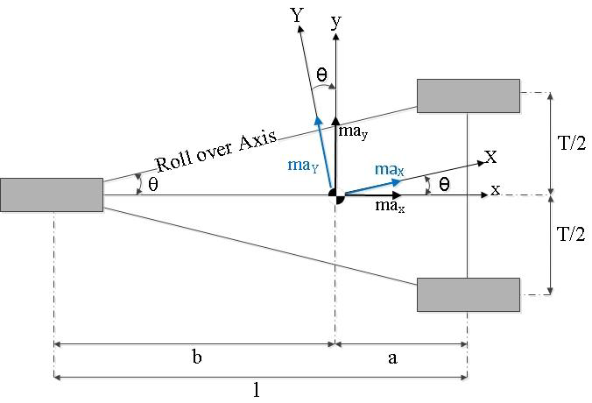
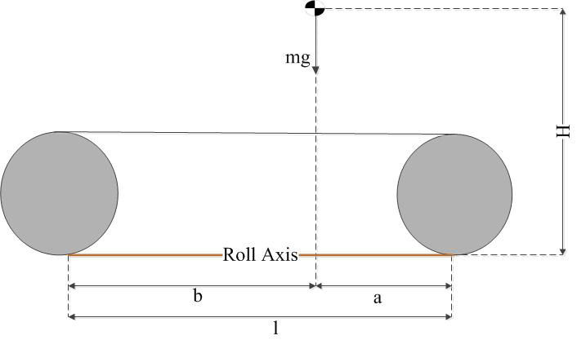




$$θ=\tan^{−1}(T/2l)$$
$$ma_{Y}=ma_{y}cos∅−ma_{x}sin∅$$
$$ma_{X}=ma_{x}cos∅+ma_{y}sin∅$$
$$ma_{z}=mg$$

Slide 23
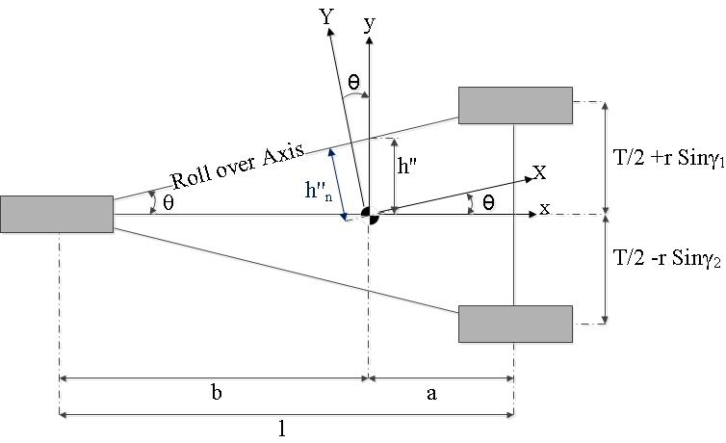








$$M=0$$
$$a_{y}=\frac{\frac{Tbgcoθ}{2l}+Ha_{x}sinθ}{Hcosθ}$$
$$\vec{e}=1i+0j+0k$$
Momentum only considering about parallel to
New x axis or rollover axis
$$\vec{r}=0i+{h"}_{n}j+Hk$$
$$\frac{h"}{t/2}=b/l$$
$$M=\begin{matrix}1 & 0 & 0 \\ 0 & tbcosθ/2l & H \\ ma_{x}cosθ+ma_{y}sinθ & ma_{x}cosθ+ma_{y}sinθ & mg\end{matrix}$$
$$h"=tb/2l$$
$${h"}_{n}=h"cosθ$$

Slide 24
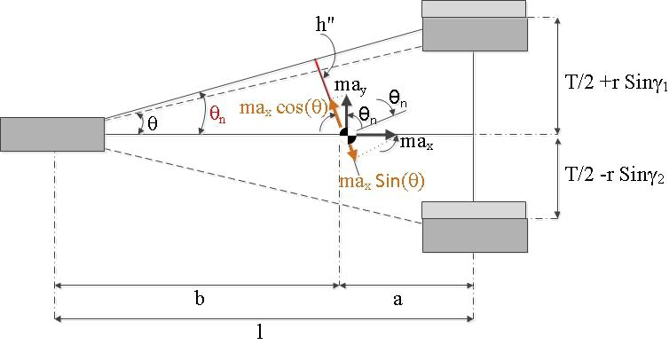



Applying one positive and negative camber angles to front wheels
$$θ_{n}=\tan^{−1}((\frac{t}{2}+rsinγ_{1})/l)$$
$$h^{"}=b\left(\frac{\frac{t}{2}+rsinγ_{1}}{l}\right)cosθ_{n}$$

Slide 25
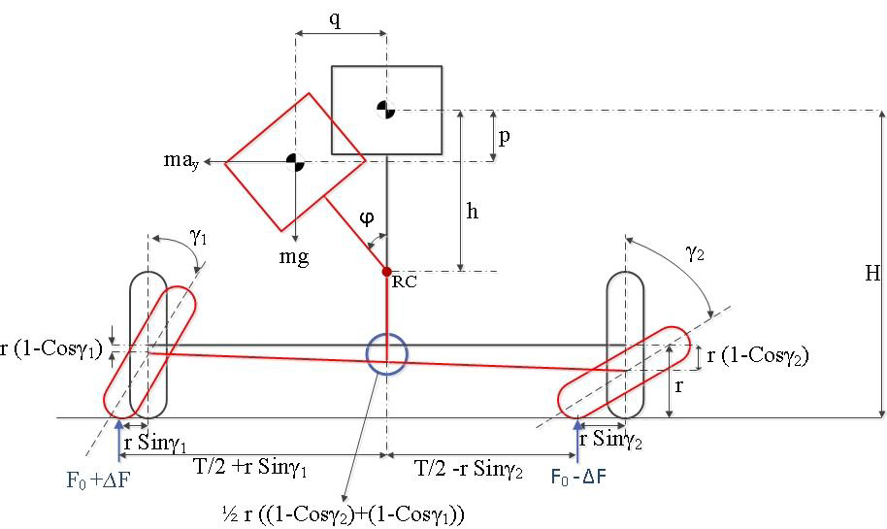





$$\vec{r}=0\vec{i}+\left(h^{"}−q\right)\vec{j}+(H−p)\vec{k}$$
$$M=0$$
The camber angle induced roll angle affects the cg position
Change in ateral direction
$$q=hsinφ$$
$$a_{y}=\frac{\left(T+{2rsin}_{γ1}\right)bgcosθ_{n}−2lhgsinφ}{\left(H−p\right)2lcosθ_{n}}+\frac{a_{x}sinθ_{n}}{{cosθ}_{n}}$$
Change in vertical direction
$p=h\left(1−cosφ\right)+\frac{rb}{2l}(\left(1−cosγ_{1}\right)+(1$-cos$γ_{2}))$

Slide 26






All wheel cambered
$${hnew}^{"}=b\left(\frac{\frac{t}{2}+rsinγ_{1}}{l+k}\right)cosθ_{m}$$
$$p_{m}=h\left(1−cosφ\right)+\frac{rb}{2(l+k)}\left(\left(1−cosγ_{1}\right)+\left(1\text{−}\text{cos}γ_{2}\right)\right)+r(1−{sinγ}_{3}\text{)}$$
Change in effective length because three camber angles
$$k=lr{sinγ}_{3}/(\frac{T}{2}+r({sinγ}_{1}−{sinγ}_{3})$$
$$\vec{r}=0i+\left({hnew}^{"}−q\right)j+(H−p_{m})k$$
$$M=0$$
New theta because of change in rollover axis
$$a_{y}=\frac{\left(T+{2rsin}_{γ1}\right)bgcosθ_{m}−2(l+k)hgsinφ}{\left(H−p\right)2(l+k)cosθ_{m}}+\frac{a_{x}sinθ_{m}}{{cosθ}_{m}}$$
$$θ_{m}=\tan^{−1}(\frac{\frac{t}{2}+rsinγ_{1}}{k+l})$$

Slide 27
Front wheel cambered
U=15kM/Hr
No | Camber angle outer wheel (deg) | Camber angle inner wheel (deg | Roll angle | Lateral acceleration threshold (g) | Cambering and not cambering difference in terms of threshold (%)
1 | 5 | 5 | 0.1931 | 0.777982 | 0.131199
2 | 10 | 10 | 0.3862 | 0.779103 | 0.275518
3 | 15 | 15 | 0.5793 | 0.780122 | 0.406717
4 | 20 | 20 | 0.7724 | 0.781244 | 0.551036
5 | 25 | 25 | 0.9655 | 0.782263 | 0.682236
6 | 30 | 30 | 1.159 | 0.783282 | 0.813435

Slide 28
Front wheel cambered
U=40kM/Hr
No | Camber angle outer wheel (deg) | Camber angle inner wheel (deg) | Roll angle (rad) | Lateral acceleration threshold (g) | Cambering and not cambering difference in terms of threshold (%)
1 | 5 | 5 | 0.5151 | 0.779817 | 0.367358
2 | 10 | 10 | 0.8242 | 0.781448 | 0.577276
3 | 15 | 15 | 1.339 | 0.784302 | 0.944634
4 | 20 | 20 | 1.854 | 0.787156 | 1.311992
5 | 25 | 25 | 2.37 | 0.79001 | 1.679349
6 | 30 | 30 | 2.885 | 0.792864 | 2.046707

Slide 29
U=65kM/Hr
No | Camber angle outer wheel (deg) | Camber angle inner wheel (deg | Roll angle | Lateral acceleration threshold (g) | Cambering and not cambering difference in terms of threshold (%)
1 | 5 | 5 | 0.5022 | 0.779715 | 0.354238
2 | 10 | 10 | 1.339 | 0.784302 | 0.944634
3 | 15 | 15 | 2.176 | 0.788991 | 1.54815
4 | 20 | 20 | 3.103 | 0.79368 | 2.151666
5 | 25 | 25 | 3.85 | 0.798369 | 2.755182
6 | 30 | 30 | 4.687 | 0.80316 | 3.371818

Slide 30
U=90kM/Hr
No | Camber angle outer wheel (deg) | Camber angle inner wheel (deg | Roll angle | Lateral acceleration threshold | Cambering and not cambering difference in terms of threshold (%)
1 | 5 | 5 | 0.694 | 0.780734 | 0.485437
2 | 10 | 10 | 1.851 | 0.787156 | 1.311992
3 | 15 | 15 | 3.007 | 0.793578 | 2.138546
4 | 20 | 20 | 4.164 | 0.800102 | 2.978221
5 | 25 | 25 | 5.32 | 0.806728 | 3.831015
6 | 30 | 30 | 6.477 | 0.813456 | 4.69693

Slide 31
All wheel cambered
U=15km/Hr
No | Camber angle outer wheel (deg) | Camber angle inner wheel (deg | Camber angle rear wheel (deg) | Roll angle(rad) | Lateral acceleration threshold (g) | Cambering and not cambering difference in terms of threshold (%)
1 | 0 | 0 | 0 | 0.1159 | 0.816514 | 5.090527
2 | 5 | 5 | 5 | 0.2317 | 0.817329 | 5.195487
3 | 10 | 10 | 10 | 0.3476 | 0.817839 | 5.261086
4 | 15 | 15 | 15 | 0.4634 | 0.818552 | 5.352926
5 | 20 | 20 | 20 | 0.5793 | 0.819164 | 5.431645
6 | 25 | 25 | 25 | 0.6951 | 0.819878 | 5.523485

Slide 32
All wheel cambered
U=40km/Hr
No | Camber angle outer wheel (deg) | Camber angle inner wheel (deg | Camber angle rear wheel (deg) | Roll angle(rad) | Lateral acceleration threshold (g) | Cambering and not cambering difference in terms of threshold (%)
1 | 0 | 0 | 0 | 0.3091 | 0.817635 | 5.234846
2 | 5 | 5 | 5 | 0.6181 | 0.819368 | 5.457885
3 | 10 | 10 | 10 | 0.9272 | 0.821101 | 5.680924
4 | 15 | 15 | 15 | 1.236 | 0.822936 | 5.917082
5 | 20 | 20 | 20 | 1.545 | 0.824771 | 6.153241
6 | 25 | 25 | 25 | 1.854 | 0.826504 | 6.376279

Slide 33
All wheel cambered
U=65km/Hr
No | Camber angle outer wheel (deg) | Camber angle inner wheel (deg | Camber angle rear wheel (deg) | Roll angle(rad) | Lateral acceleration threshold (g) | Cambering and not cambering difference in terms of threshold (%)
1 | 0 | 0 | 0 | 0.5052 | 0.818654 | 5.366046
2 | 5 | 5 | 5 | 1.004 | 0.821611 | 5.746523
3 | 10 | 10 | 10 | 1.507 | 0.824465 | 6.113881
4 | 15 | 15 | 15 | 2.009 | 0.827421 | 6.494358
5 | 20 | 20 | 20 | 2.511 | 0.830275 | 6.861716
6 | 25 | 25 | 25 | 3.013 | 0.833231 | 7.242194

Slide 34
All wheel cambered
U=90km/Hr
No | Camber angle outer wheel (deg) | Camber angle inner wheel (deg | Camber angle rear wheel (deg) | Roll angle(rad) | Lateral acceleration threshold (g) | Cambering and not cambering difference in terms of threshold (%)
1 | 0 | 0 | 0 | 0.694 | 0.819776 | 5.510365
2 | 5 | 5 | 5 | 1.388 | 0.823751 | 6.022041
3 | 10 | 10 | 10 | 2.082 | 0.827829 | 6.546838
4 | 15 | 15 | 15 | 2.776 | 0.831804 | 7.058515
5 | 20 | 20 | 20 | 3.47 | 0.835882 | 7.583311
6 | 25 | 25 | 25 | 4.164 | 0.839959 | 8.108108

Slide 38
Thank you

